Slide 1

Towards a distributed model of real estate
06 November 2020

Slide 2
Topics we will cover
Case study: HM Land Registry’s prototype
Further examples: blockchain in real estate and construction
The role of private and public sector entities
MDRxTECH

Slide 3
Case study
HM Land Registry’s prototype

Slide 4
HM Land Registry’s prototype
Digital Street
In 2016 HM Land Registry conducting a board-level sponsored review of its processes and published its strategy in an increasingly digital world.
Among its ambitions was to “become the world’s leading land registry for speed, simplicity and an open approach to data.”
Digital Street was born.

Slide 5
HM Land Registry’s prototype
The use case: conveyancing
The term “conveyance” refers to the legal process of transferring property from one owner to another. This process often includes the granting and redeeming of an encumbrance such as a mortgage or lien.
Slow
Expensive
Stressful

Slide 6
HM Land Registry’s prototype
Solution overview
The HMLR implementation involved the creation of a DLT-based application, built on Corda, using a simplified number of transaction nodes to facilitate a DLT-based transfer of a residential property.
The project consisted of three stages: (1) mapping the conveyancing user journey (2) building a prototype application (3) establishing a distributed network to perform a shadow conveyance

Slide 7
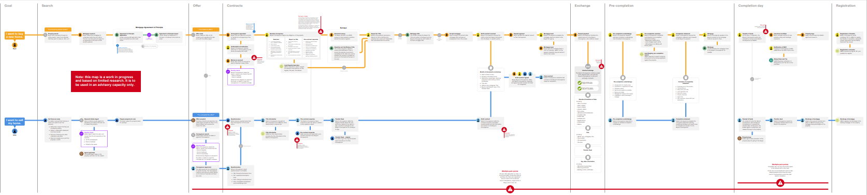
HM Land Registry’s prototype
Solution overview: mapping the conveyancing user journey
Full scale diagram available on our Git here.

Slide 8
HM Land Registry’s prototype
Solution overview: building a prototype application
We spun up a CorDapp across a private
DLT system comprised of seven nodes, all hosted within HMLR’s cloud-based development environment.
The CorDapp represented the real-life land titles as digital assets that could be recorded and tracked throughout their entire lifecycle (Linear States).
HMLR retained an important role in the process by providing the single source of truth for the CorDapp to rely on when
determining land title ownership.

Slide 9
HM Land Registry’s prototype
Solution overview: performing a shadow conveyance
On the 6 March 2019 the sale of a recently refurbished, semidetached house in Gillingham had completed. The entire process had taken 22 weeks to complete against an initial estimate of six weeks.
We deployed our DLT-based proof of concept to the same transaction – the application ran the conveyance through, end to end, in less than 10 minutes.
Full whitepaper can be found here.

Slide 10
HM Land Registry’s prototype
Client feedback
HMLR confirmed that they “learned a lot of valuable things” during the project and that they “found that significant parts of the
industry remained open to innovation.”
HMLR further acknowledged
that they “cannot fix the problems the industry faces alone, and it therefore needs to be a collaborative effort.”
“Blockchain should be invisible to citizens and I think what it will mean for them is a home buying process that is more straight forward, easier and less full of stress. It’s an emerging technology that offers a good opportunity for the
industry to explore further.”
Eddie Davies Deputy Director of Digital Services HM Land Registry

Slide 11
Further examples
Blockchain in real estate and construction

Slide 12
Blockchain in real estate and construction
Further examples: supply chains
Existing real estate and construction supply chains often involve siloed datasets which result in an opaque environment in which most stakeholders are often unaware of where their goods are.
This issue is compounded where the goods in question need to be transported in a certain manner
and subject to certain conditions, for example timber that should not be exposed to a high level of moisture.
Smart contracts can also be used to automate payments as contracted obligations are fulfilled by various stakeholders along a supply chain.

Slide 13
Blockchain in real estate and construction
Further examples: building information management (BIM)
BIM systems are seldom linked to asset registries and often are siloed away from other property information.
As with any BIM implementation, IoT devices can automate the collection of data, reducing costs. A DLT-based BIM implementation can improve transparency and help plan, manage and deliver large-scale construction projects.

Slide 14
Innovation
The role of private and public sector entities

Slide 15
Innovation
The role of private and public sector entities
Private sector
Innovate
Grow
Collaborate
Comply
Public sector
Lead
Engage
Protect

Slide 16
MDRxTECH
Digital Transformation.
Compliant by design.

Slide 17




MDRxTECH
Digital transformation. Compliant by design
Digital transformation \ We empower our clients to reimagine their organisations using the world’s most advanced technologies, reassured that compliance underpins everything we do
Systems integration \ We bring together diverse and innovative technology providers and solutions from around the world and optimise them for our clients’ organisations
Legal engineering \ We build impactful solutions and take care of the compliance, so our clients can focus on achieving incredible things

Slide 18

MDRxTECH
Digital transformation. Compliant by design

Slide 19



MDRxTECH
Digital transformation. Compliant by design
Tom Grogan Head of MDRxTECH
Part of The Mishcon de Reya Group
tom.grogan@mishcon.com

